Slide 1
SSH:
--------
54.235.32.197
uncc4155ecommerce.pem
FRONTEND:
--------
/usr/share/nginx/html
BACKEND:
--------
/home/ec2-user/ecomm/backend

Slide 2
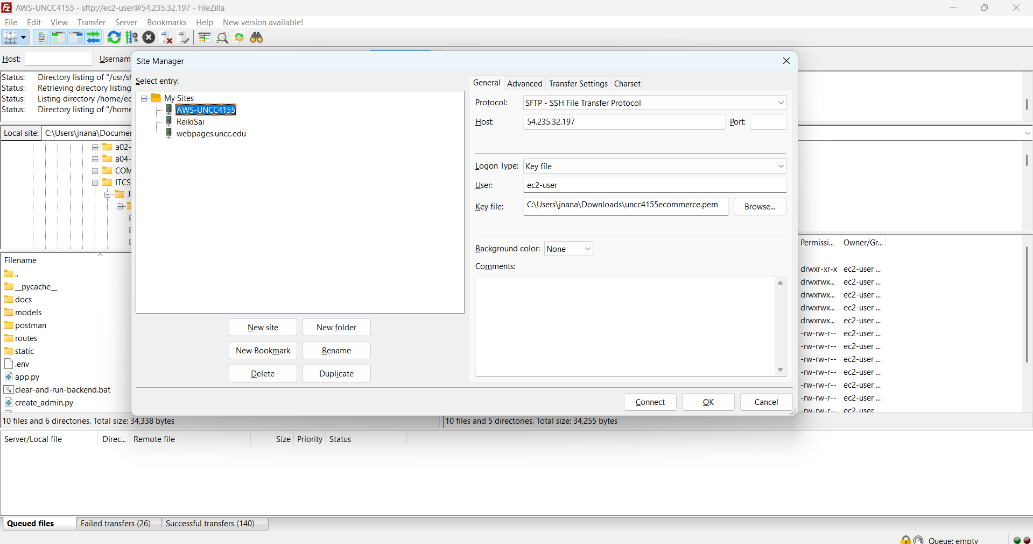
FTP SITE CONFIGURATION

Slide 3
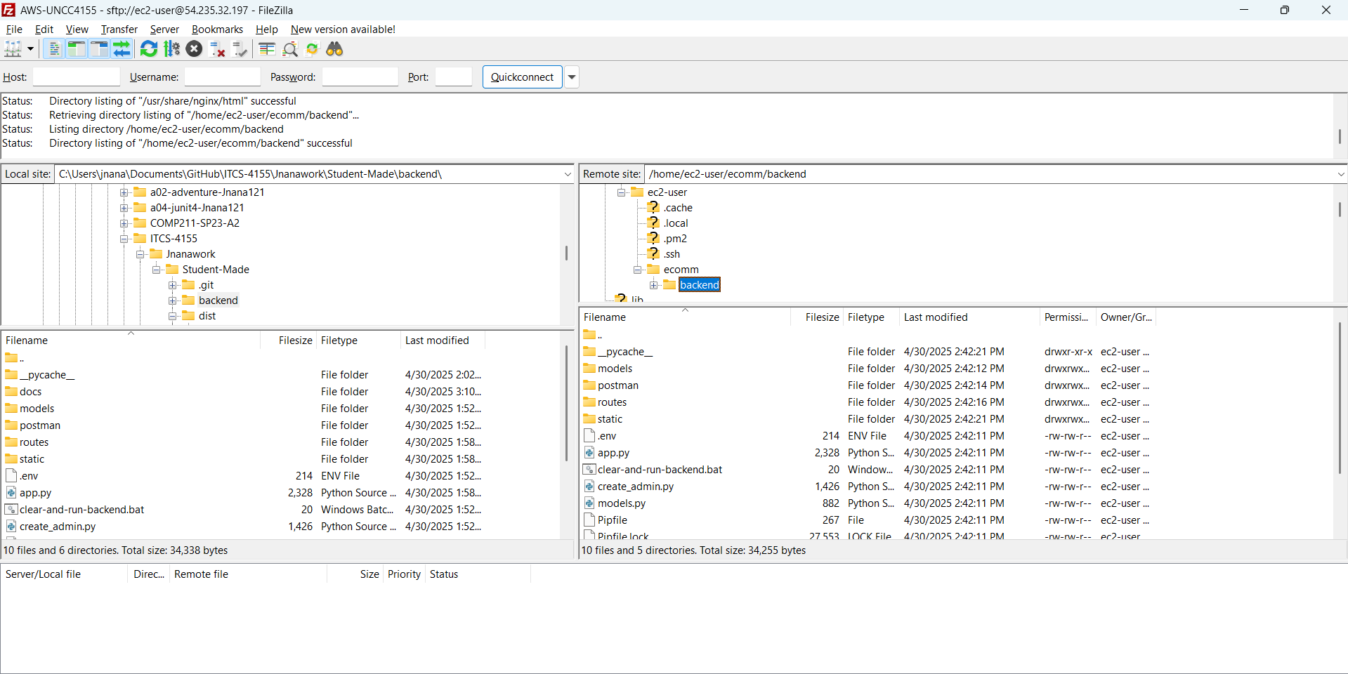
BACKEND DEPLOYMENT

Slide 4
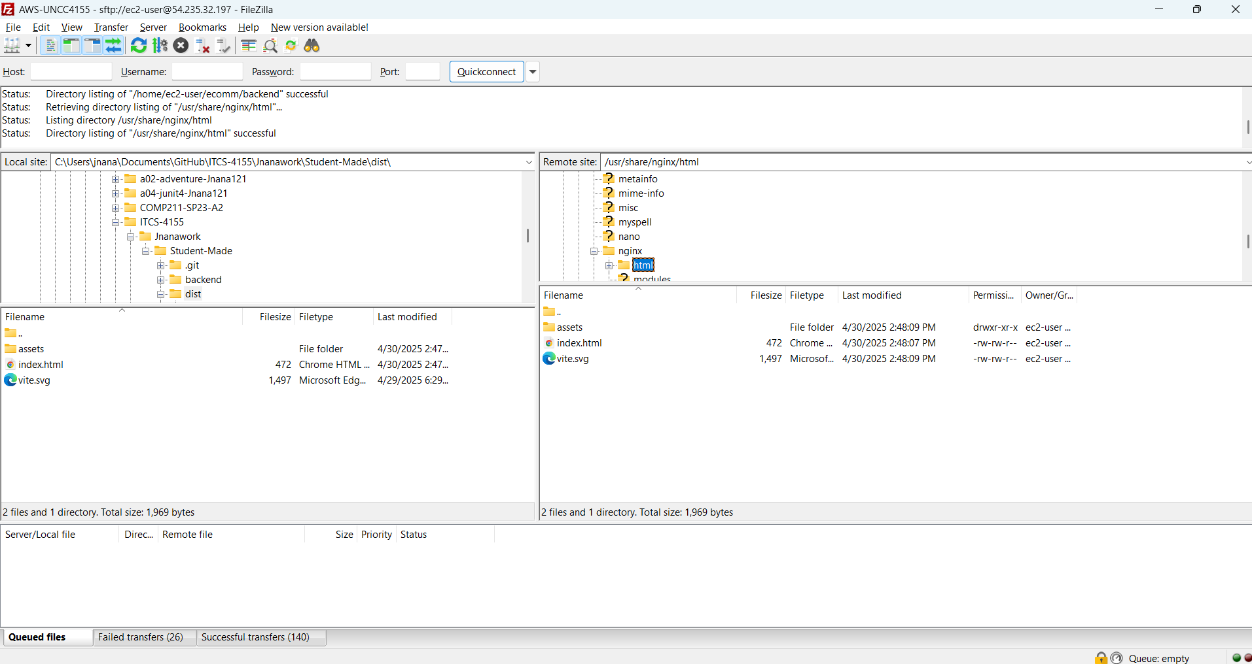
FRONTEND DEPLOYMENT

